Slide 1
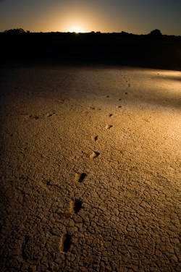
Stories of Deep Time:

Slide 2
“imagine a place that can take you back in time…
The Willandra Lakes World Heritage Area in New South Wales (NSW) Australia is one such place – taking you as far back as 50,000 years!”
Trish Albert – caring for country

Slide 3
Acknowledge:
We acknowledge the traditional owners of this land, and give respect to elders past and present

Slide 4
WELCOME TO COUNTRY
The traditional tribal groups Paakantji, Ngyiampaa and Mutthi Mutthi

Slide 5
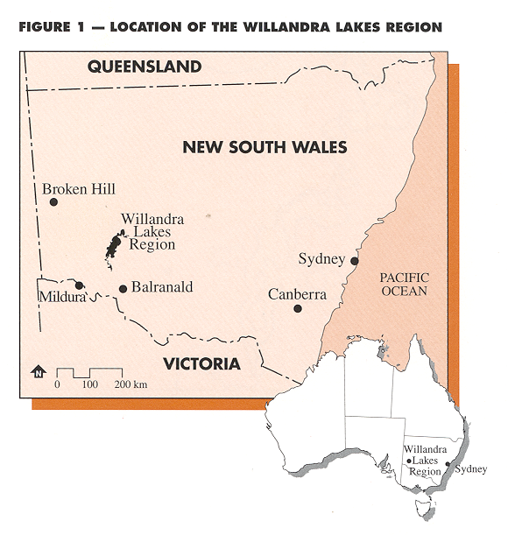

Slide 6
Deep Time
Understanding Aboriginal prehistory in Australia, which occupies 45,000+ years of Australia’s human past, is still in its infancy.
The concept of deep time in relation to the human past is a difficult one to fathom and presents a challenge to the most adept thinking.

Slide 7
80 events that changed Australia

Slide 8
Willandra Lakes REGION WORLD HERITAGE AREA
Inscribed on the World Heritage List in 1981
Natural values are centred on the excellent insight into the earth’s recent geological history.
Cultural values are based on evidence of Aboriginal occupation for at least 45,000+ years, including the oldest ritual burial and cremation, and oldest human fossil trackway.
One of only 7 listed sites relevant to the origins of humananity worldwide
One of only 25 sites worldwide inscribed for both Natural and Cultural values
Notes:
Place

Slide 9
In 2001 the NSW National Parks and Wildlife Service, in partnership with the Mungo National Park Joint Management Advisory Committee developed the Mungo National Park Joint Management Plan.
In particular, the plan identifies the use of Mungo National Park as an education resource for schools and the involvement of youth in learning about the history and culture of Mungo.

Slide 10
MUNGO
Travelling into the Heart of our human Story
What is deep time?
How do we access deep time?

Slide 11
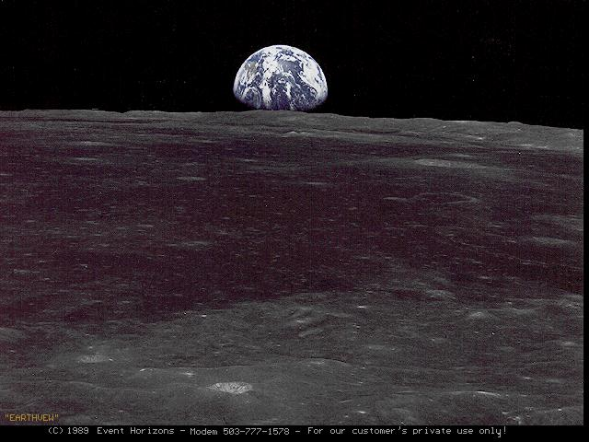
ACTIVITY - TIME
ICONIC moments over time
    Sputnik
    Columbus
    Mega Fauna
    The great pyramids of GIZA
    Mungo Woman
    Machu Picchu
    The American Constitution
    The Roman Empire
    Stone Henge
    Last Ice age
    Land Bridge to Tasmania
    Dinosaurs Extinct

Slide 12
40,000
30,000
20,000
10,000

Slide 13
Giza
Mungo Woman & Man
Mungo footprints
Stone Henge
sputnik
Tasmania
Columbus
40,000
30,000
20,000
10,000
American Constitution
Roman
Mega Fauna
Machu Picchu
Last Ice Age

Slide 14
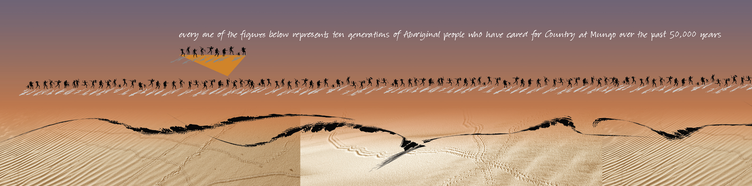
timeline
Glacial maximum
Mungo Woman
People reach Europe
‘ancient’ pyramids
People reach America
Australian
Federation
Footprints formed

Slide 15
History stretches from the distant past to the present, and provides a deeper understanding of present-day events as well as the enduring significance of earlier ones. It introduces us to a variety of human experience, enables us to see the world through the eyes of others, and enriches our appreciation of the nature of change.
Shape of the Australian Curriculum: History

Slide 16
http://sahultime.monash.edu.au/explore.html

Slide 17
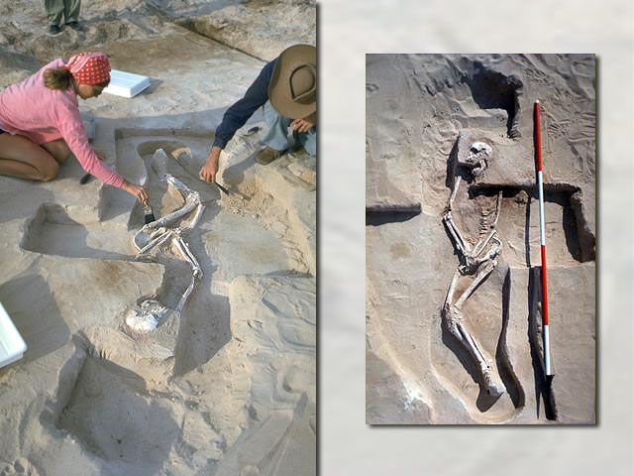
‘The very evidence of humanity itself....’

Slide 18
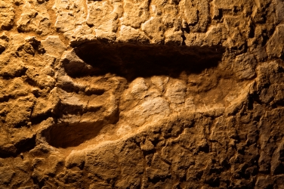

Slide 19
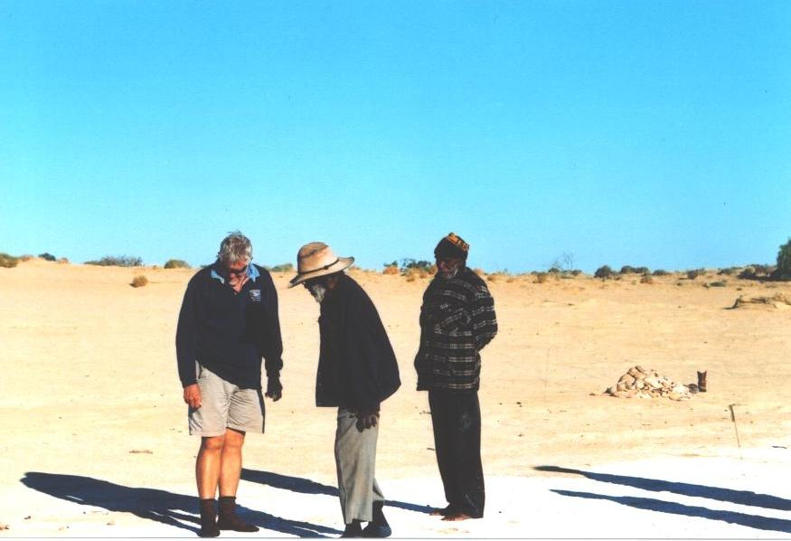

Slide 20
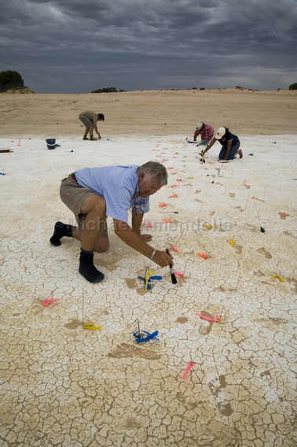
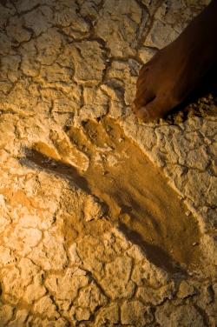

Slide 21


Slide 22
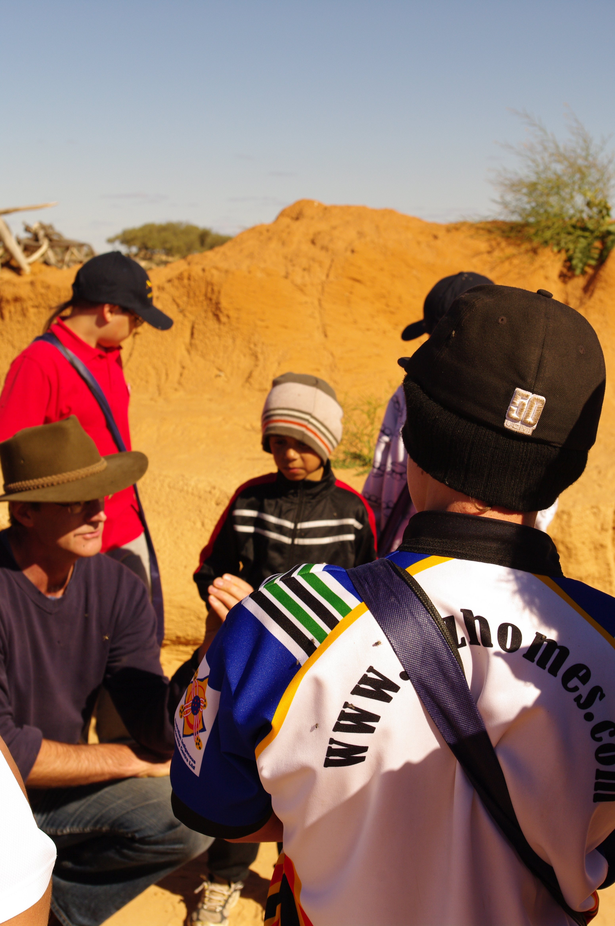
Archeologist
Harvey Johnson

Slide 23
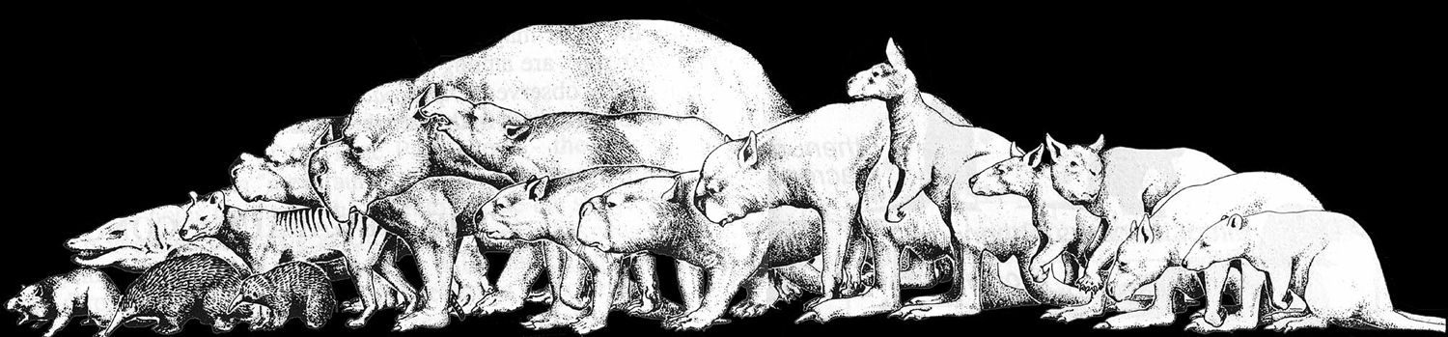
Megafauna at Mungo

Slide 24
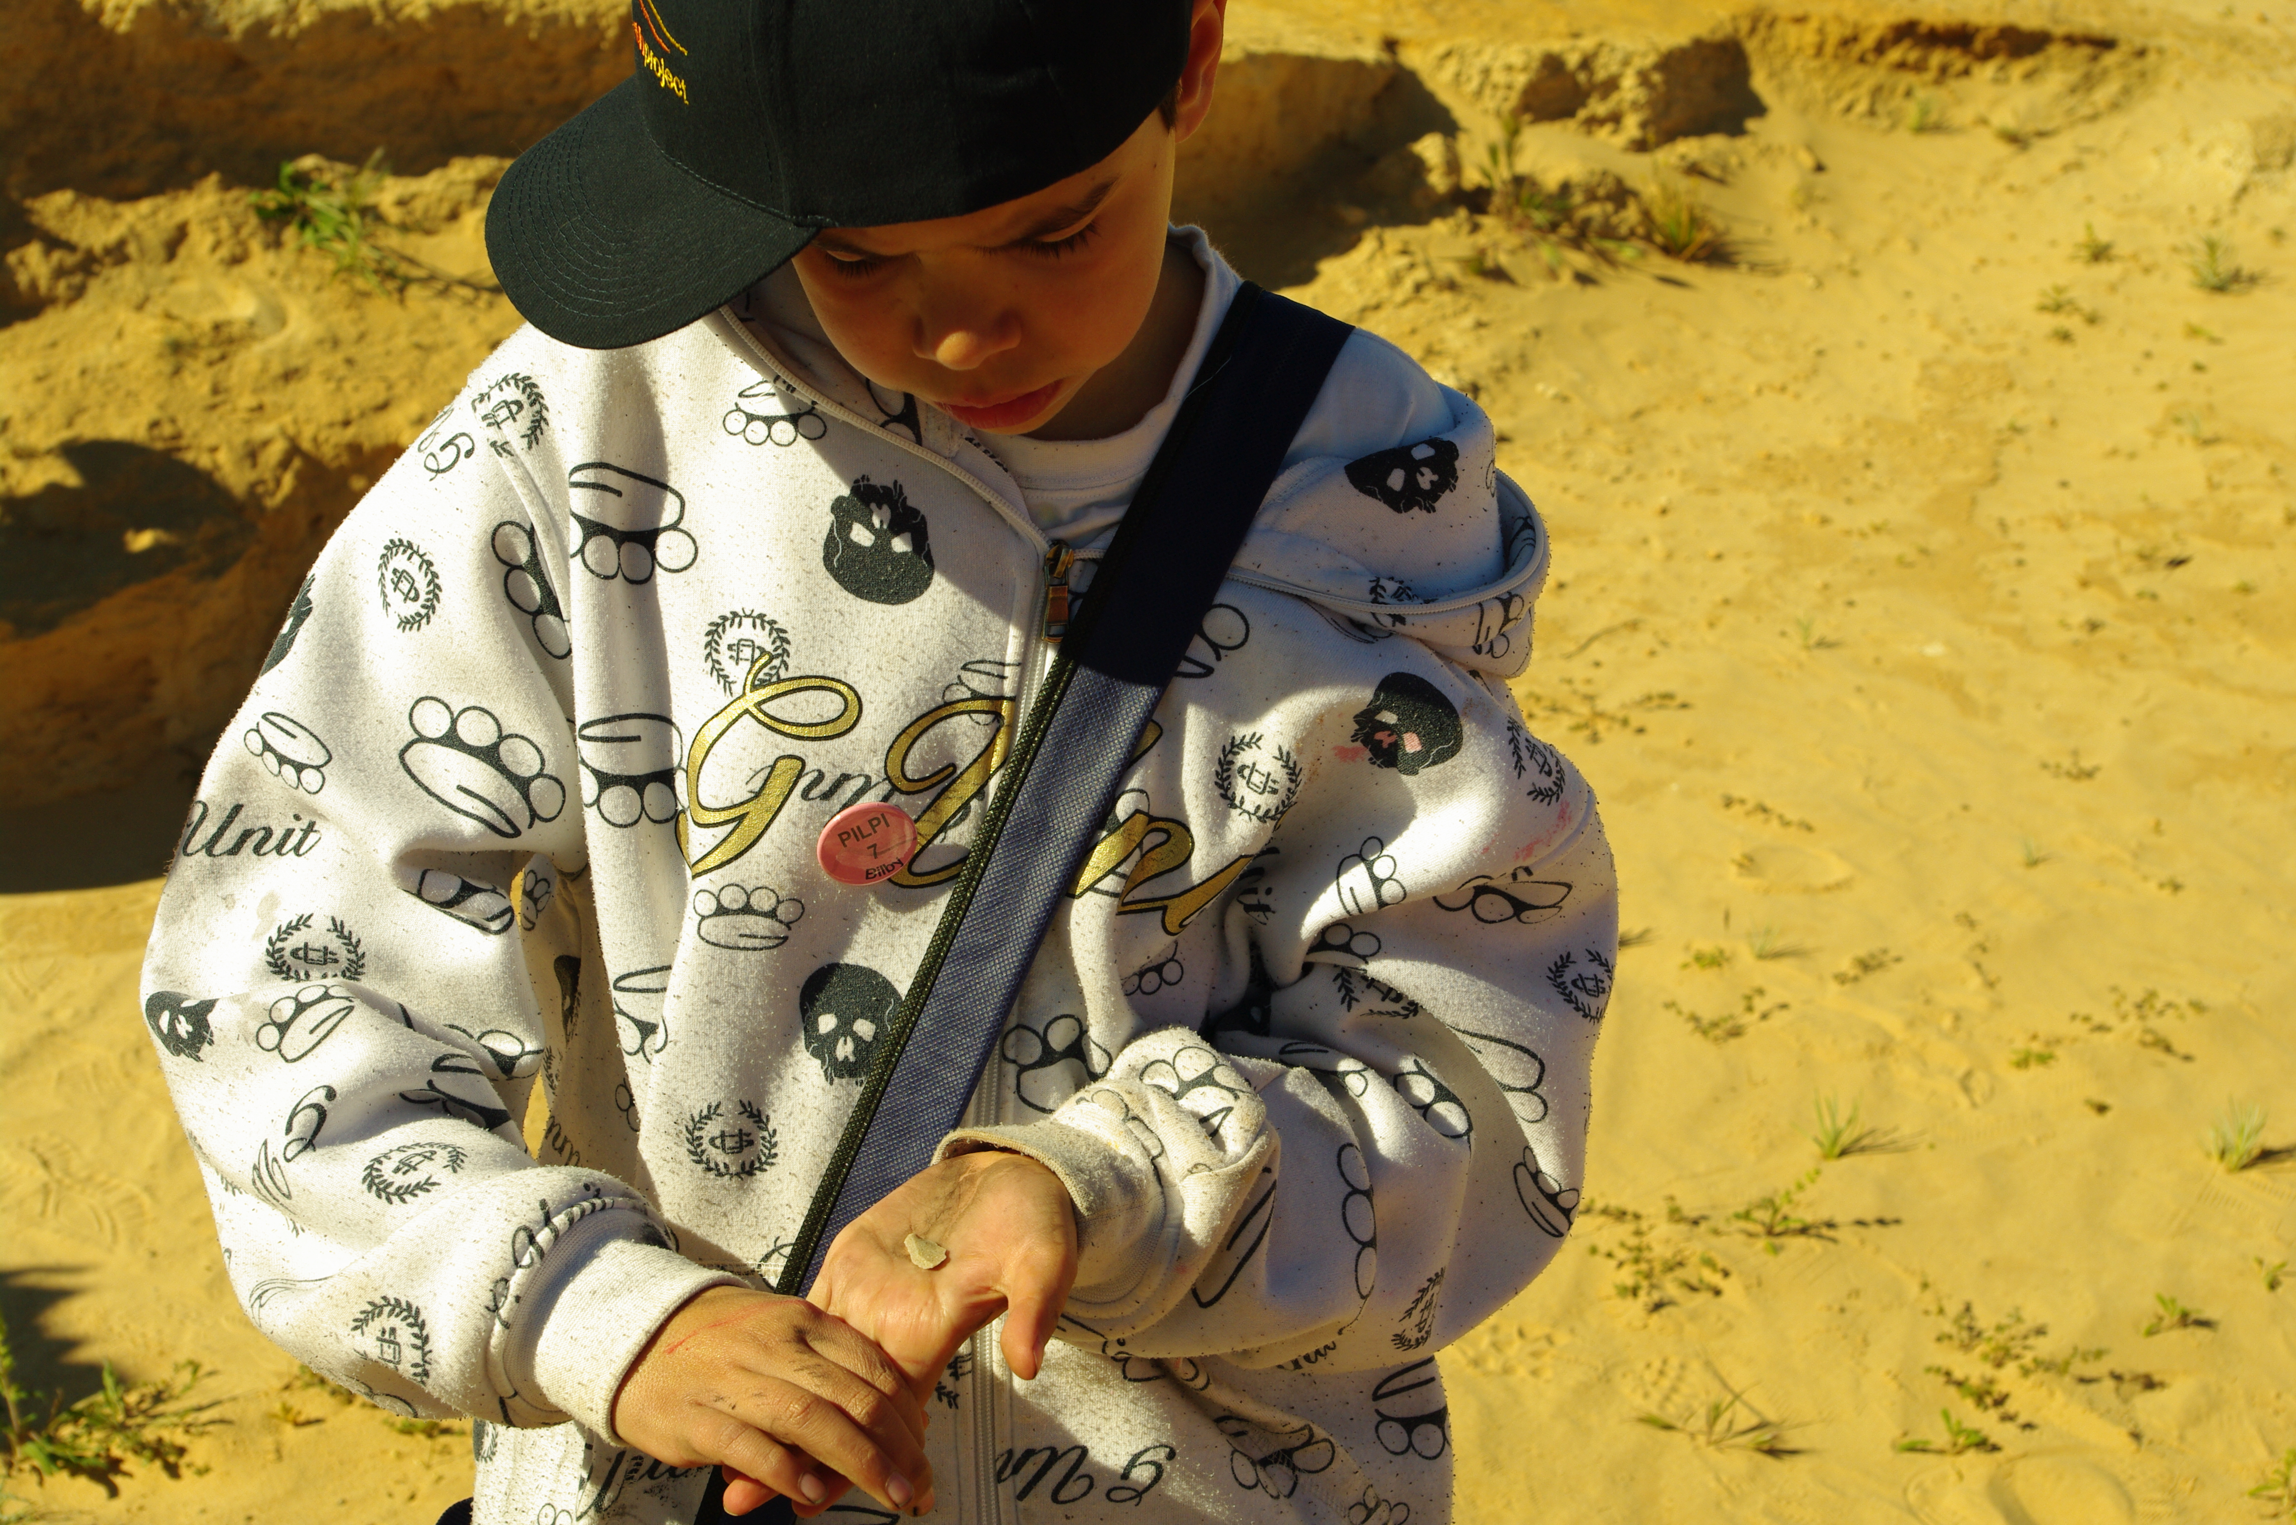
Budding archeologists with 45,000 year old Genyornis egg shell

Slide 25
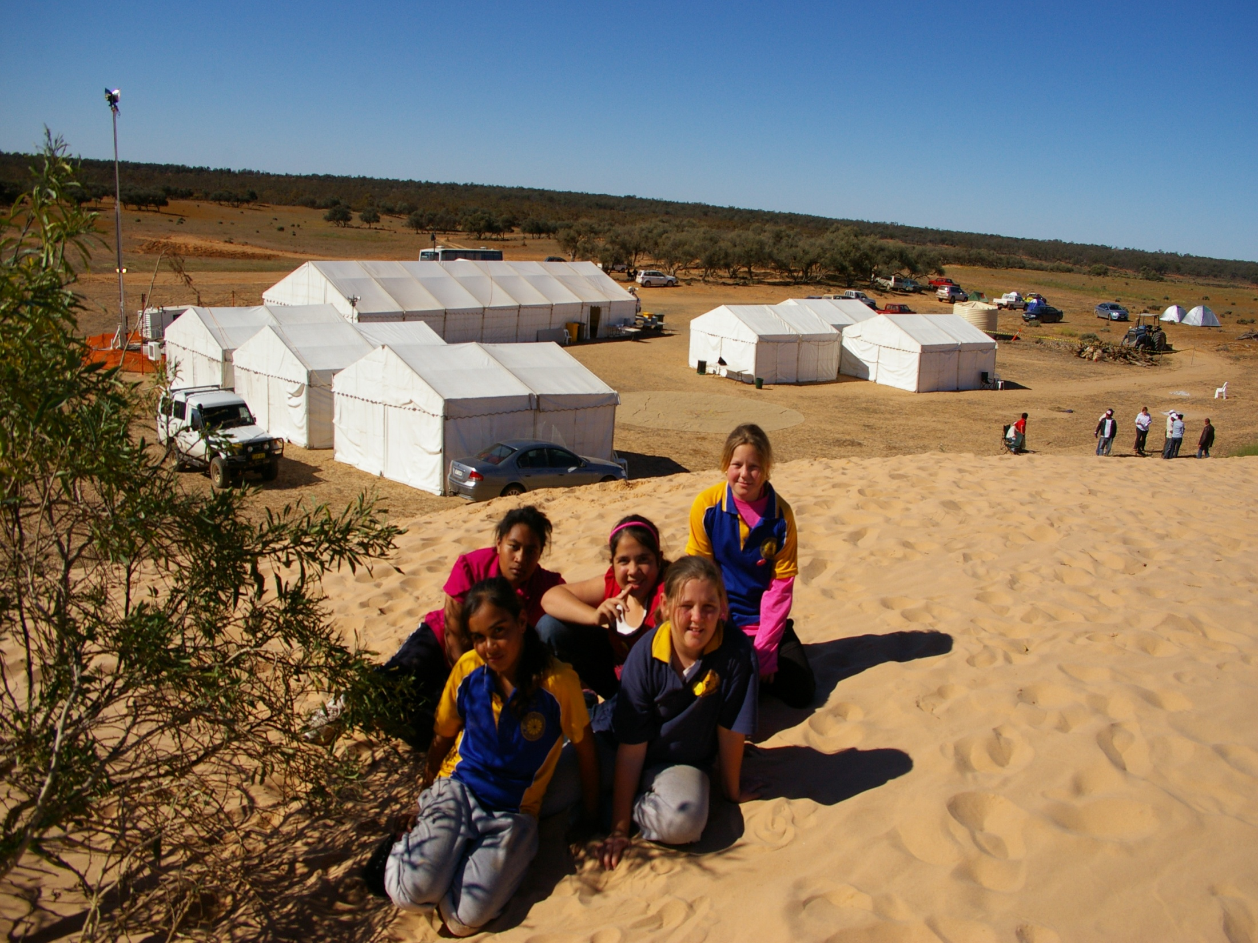
The Mungo Youth Conference occurs in a specifically constructed high tech tent community within the Willandra Lakes World Heritage area and Mungo National Park.

Slide 26
Mungo Youth Project

Slide 27
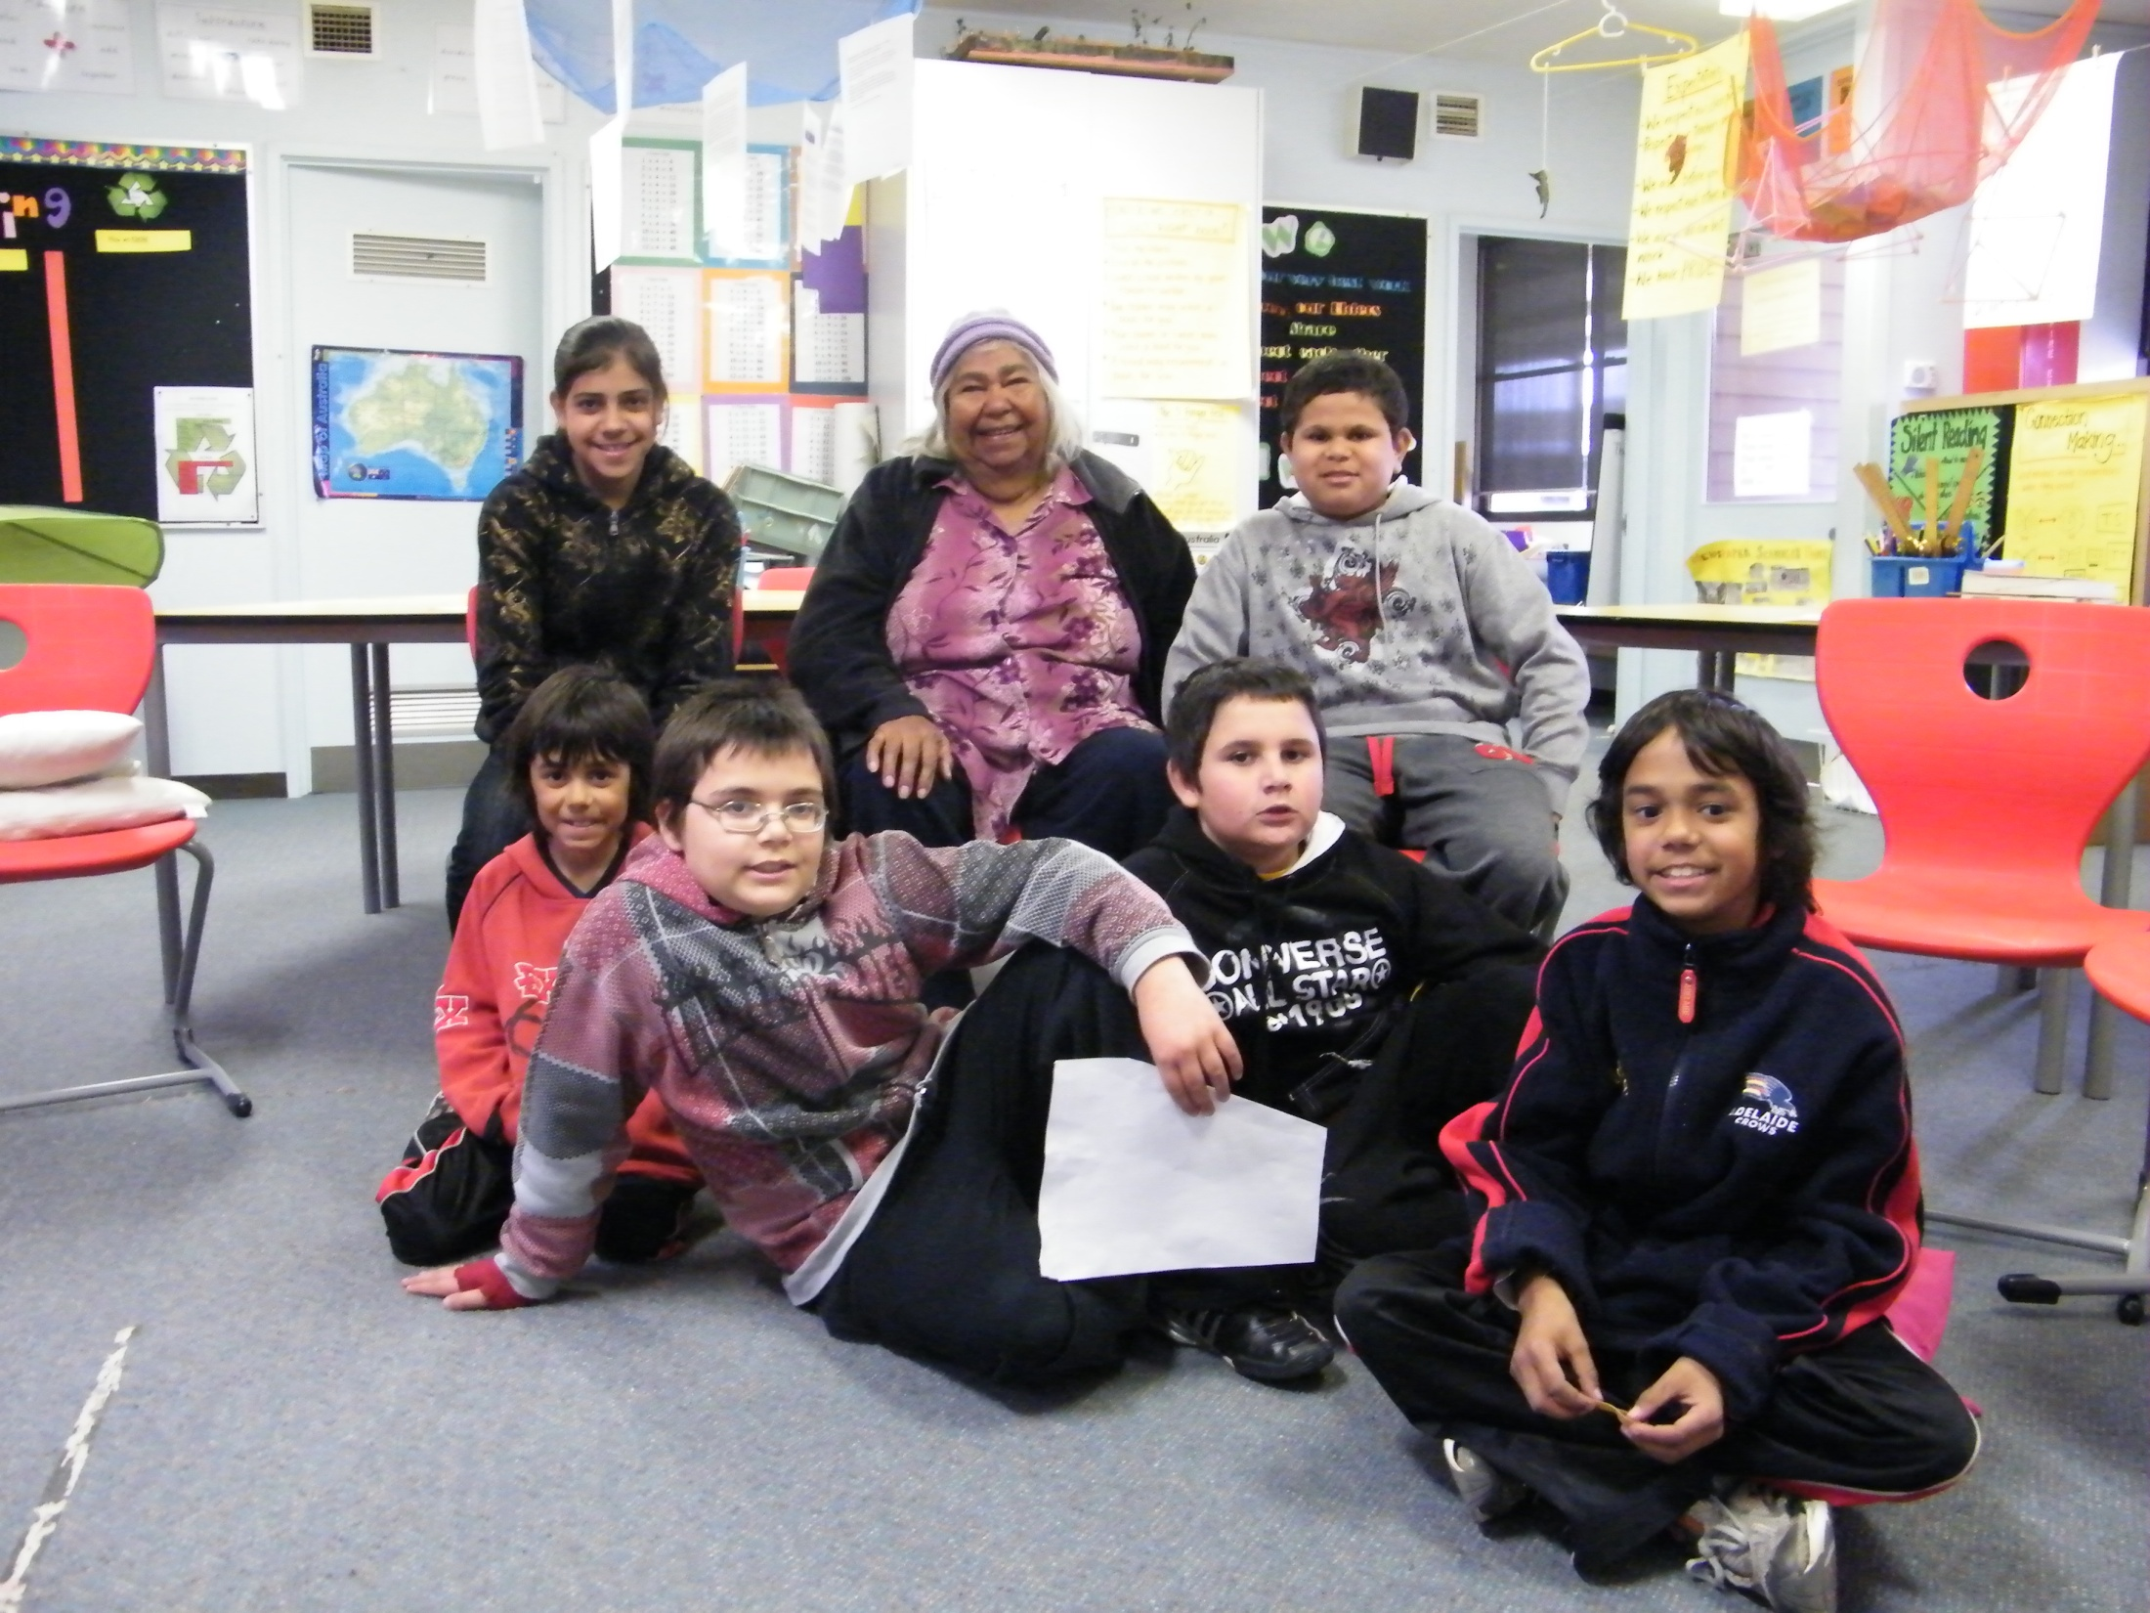
Pre conference learning, supported by mentors, ensures that students know that the Willandra Lakes region World Heritage area, including Mungo National Park, informs a major story of humanity and of Australia.

Slide 28
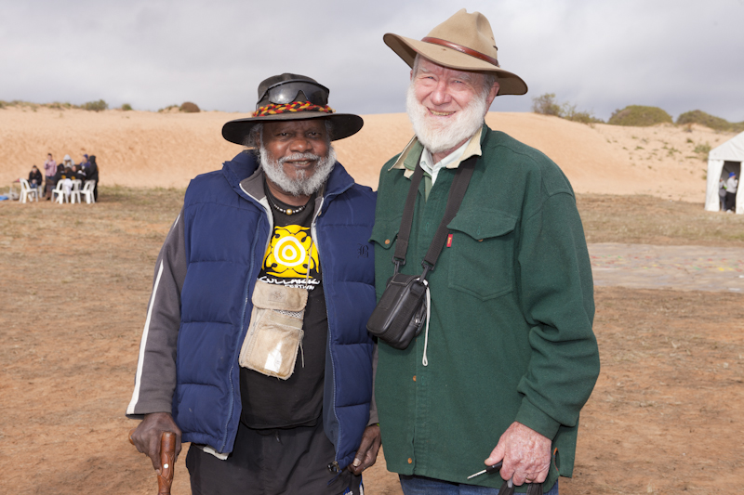

Slide 29
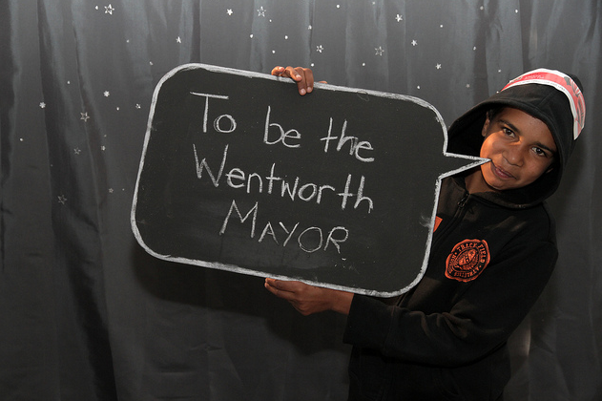

Slide 30
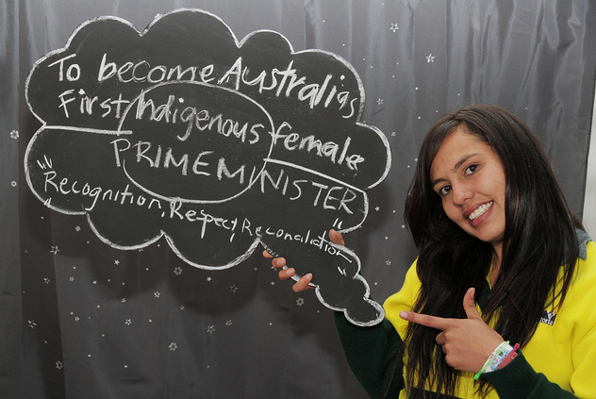

Slide 32
Some Questions for Teachers & Students
How does learning about other cultures help us understand ourselves?
What does it mean to ‘come of age’ and how does it differ across culture, time and gender?
What is reconciliation and is it achievable?
How do we find out the truth about things that happened long ago and far away?
How do scientists/ archaeologists seek to discover what is unknown?
How does archaeology help us to understand ourselves and the world we live in?

Slide 33
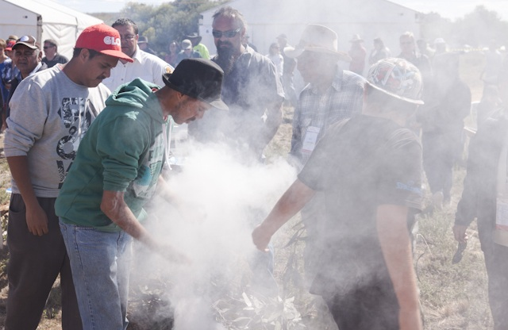
Smoking Ceremony

Slide 34
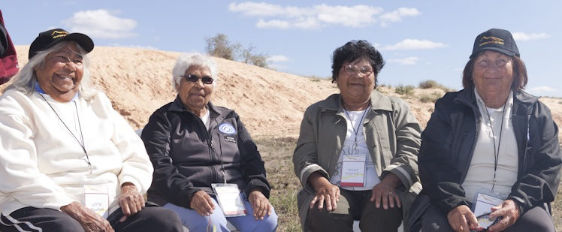

Slide 35
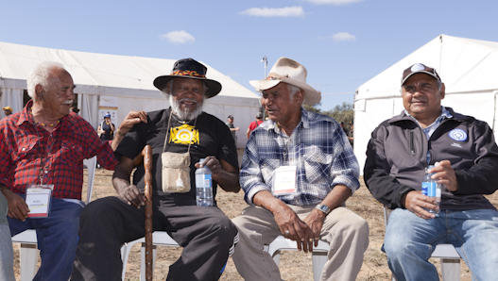

Slide 36
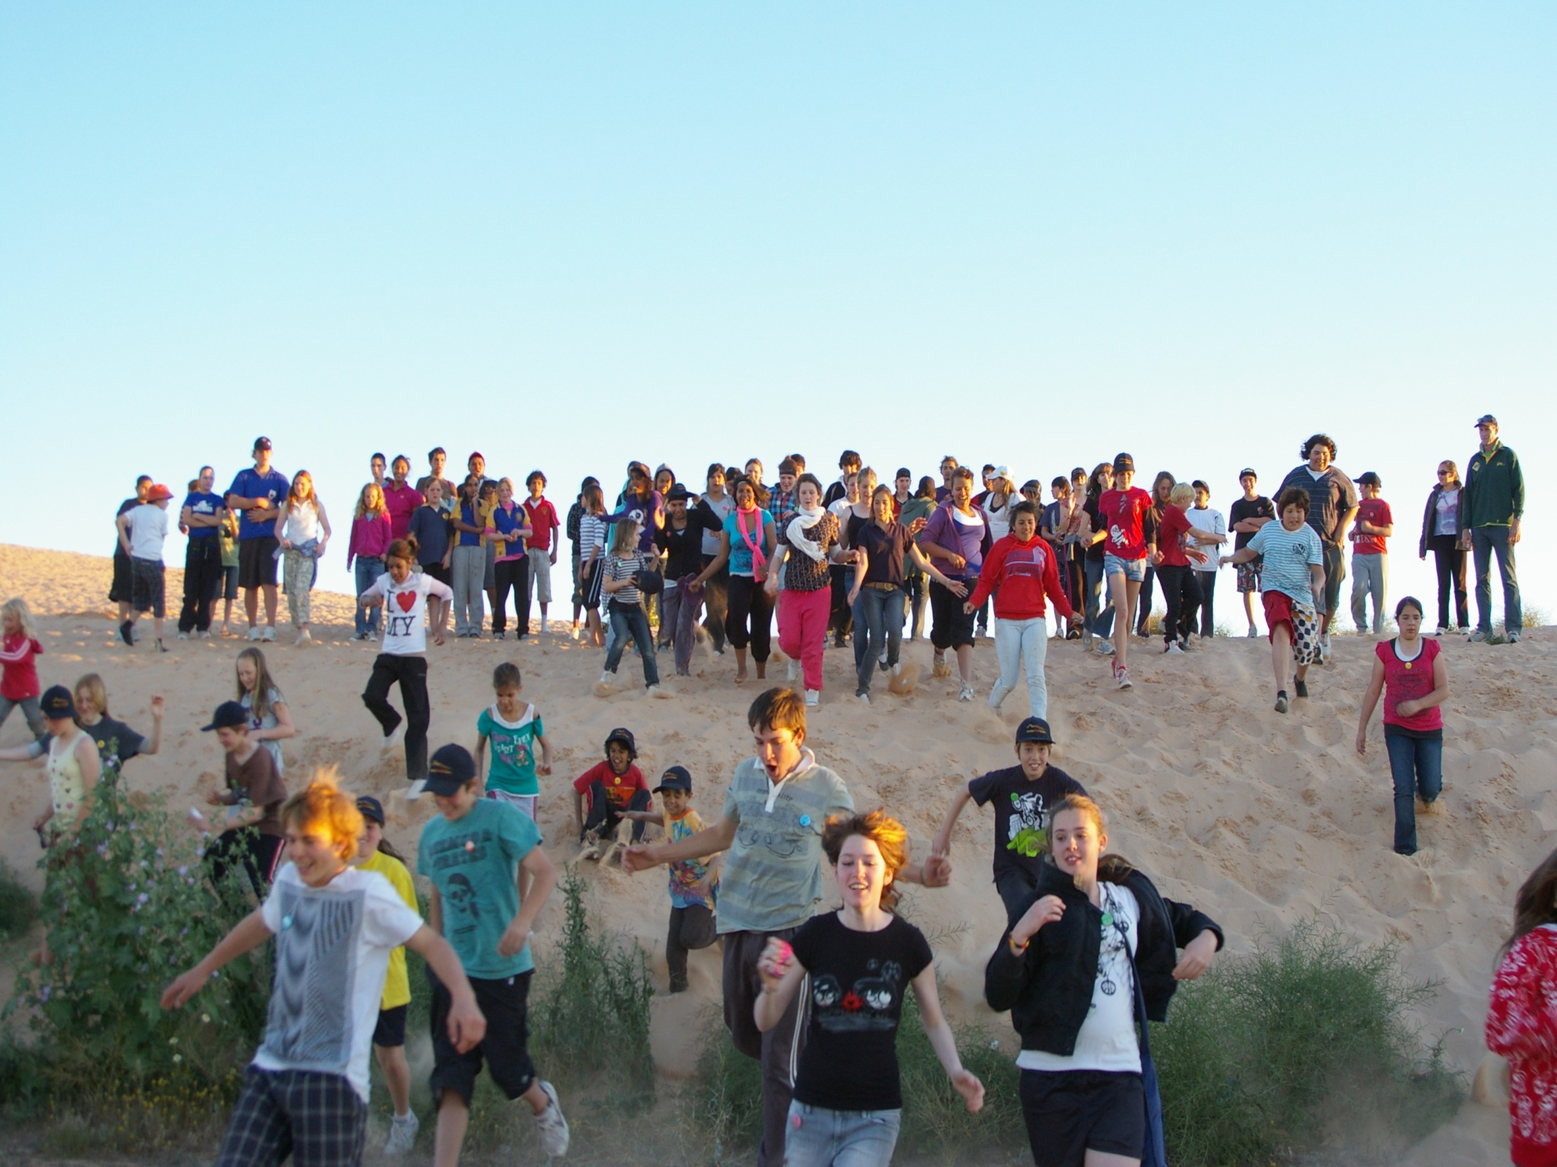
Thankyou

Slide 37
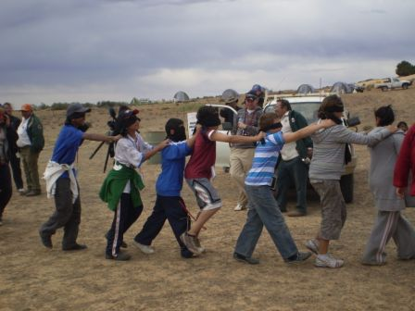
The Mungo
YouthProject
200 students 30 schools
3 months research in school
3 day conference
All students rotate through program including explorations led by Elders & Traditional Owners and with archaeologists and cultural walks
Day one - welcome to country, camp set up and orientation
Day two - presentations and exploration - Celebratory concert
Day three - presentations and home

Slide 38
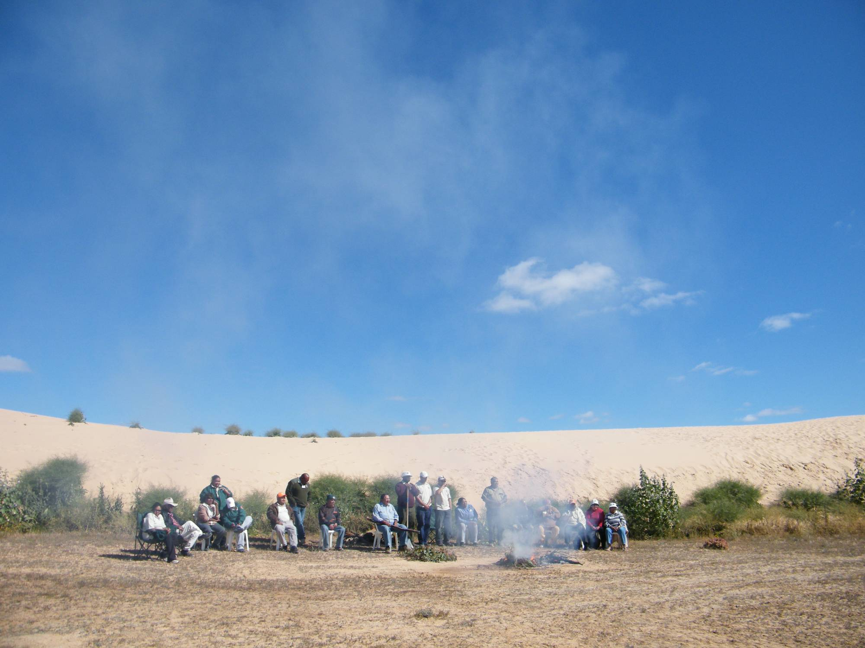
WELCOME: you have arrived at one of the world's very special places. Aboriginal people have walked here at Mungo in the footsteps of their ancestors since the Dreamtime.

Slide 39
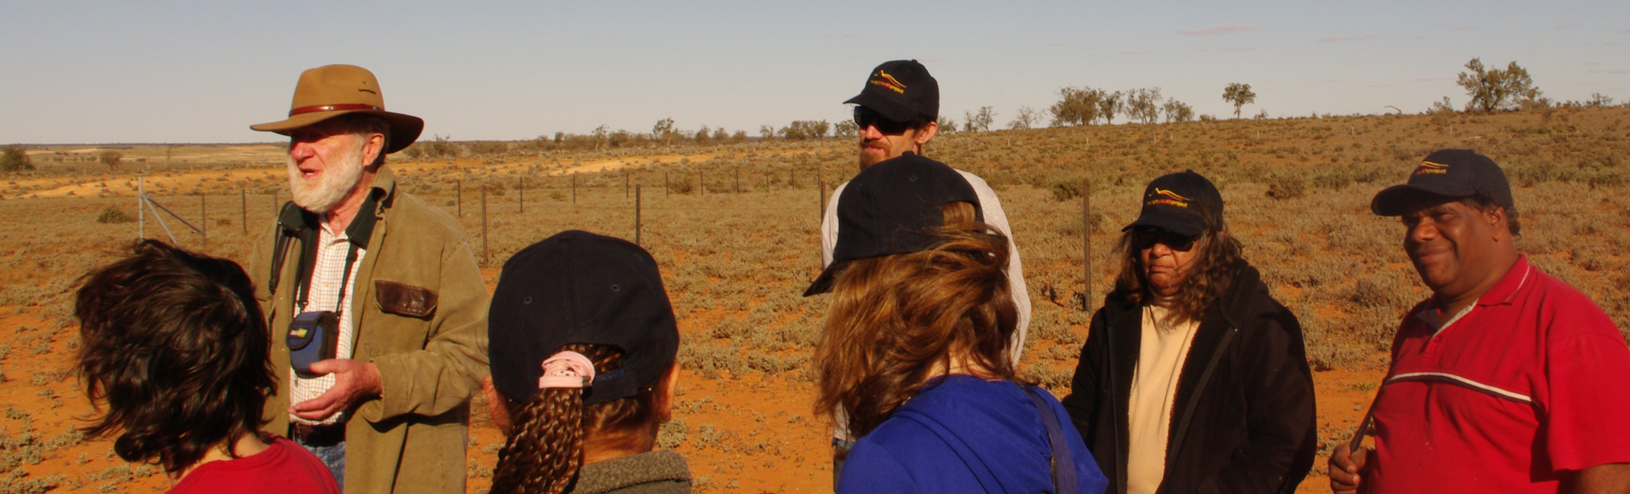
Jim Bowler with students, teachers and students
Dr Jim Bowler AM

Slide 40
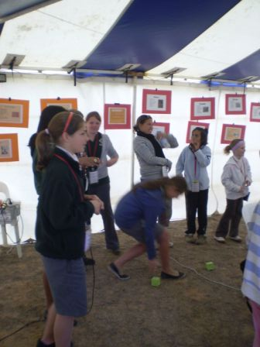
Presentation Teams
Student teams are selected through application. There are two teams per topic
Each presentation team receives mentoring support through Traditional Owners, scientists and archaeologists

Slide 41
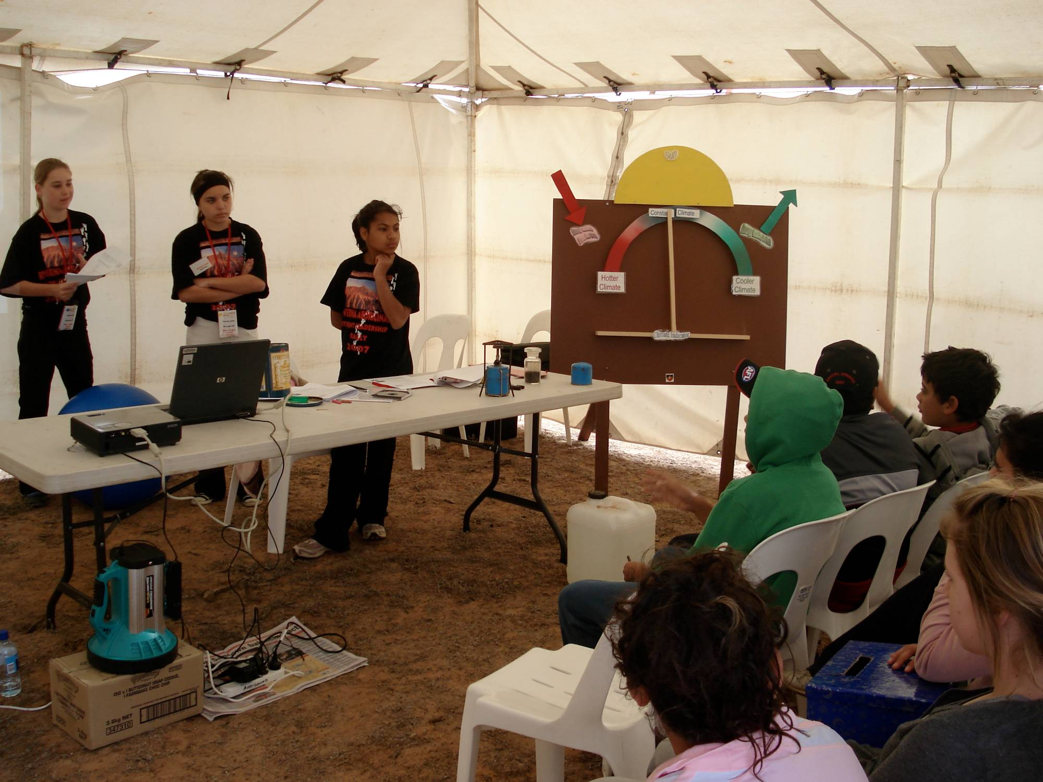
Notes:
41

Slide 42
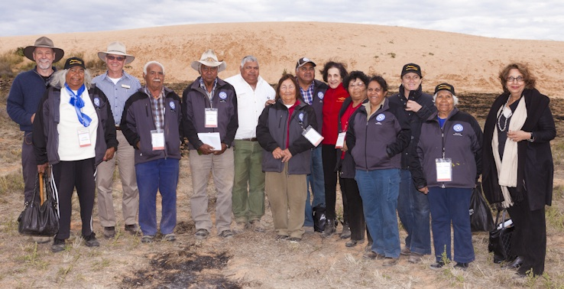

Slide 43
THE MUNGO YOUTH PROJECT
Aims to create an authentic student centred approach to learning about the deep history and Aboriginal Culture of Australia
Immerse students in contemporary challenges like climate change and reconciliation
Engage with the ongoing Aboriginal connection with the landscape

Slide 44
Teaching Teachers how to teach kids to teach kids
Teachers from selected presenting schools are invited to Mungo to learn the model
A specialist coach engages with the teachers for onsite training
Coaching & mentor program will enhance teachers work through school visits & online
Key themes, essential questions and the IMPORTANCE of hands on activities
Resources and timelines considered

Slide 46
Purpose
The Mungo Youth Project connects young people with Elders, traditional owners, archaeologists, pastoralists, park rangers and scientists to directly engage with the oldest continuous human presence and adaptive culture on the planet.
The Mungo Youth Project exemplifies the “kids teaching kids” model

Slide 49
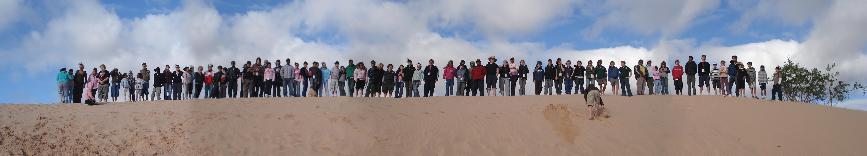
The Mungo Youth Conference created a framework of Powerful Learning & featured:
Student led presentations [learning so as to teach].
Engagement with Traditional Owners
Archaeological activities
Team building & student leadership
Cultural events
Role models – artistic, sporting & professional
Creative performances, new media

Slide 50
Presenters
TANYA CHARLES (Mutthi Mutthi )
Coordinator – Discovery Rangers
Willandra Lakes Region World Heritage Area
ROBERT BIGGS
Deputy Chair Mungo Youth Project

Slide 52
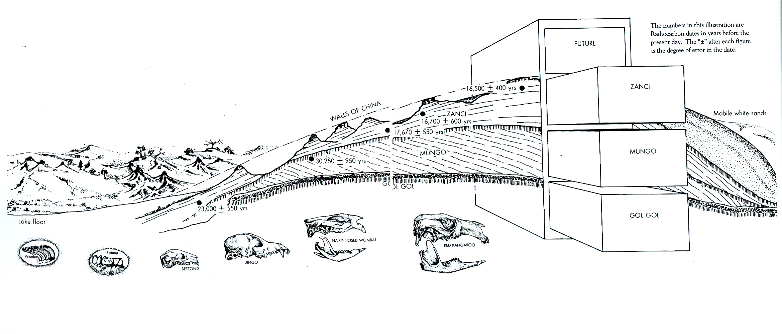
Deep time
Notes:
There are distinct signatures of humanity here which are far longer that the rest of the world

Slide 53
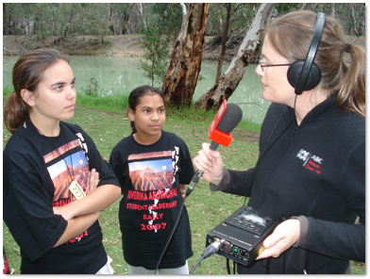
A broad national interest
Australian Broadcasting Commission interviews

Slide 54
Elders program responses
Part 1. Program Overview
Part 2. Welcome ceremonies
- Students, teachers and visitors
- The Governor NSW Prof Maree Bashir
Part 3. Elders Student engagement activities

Slide 55
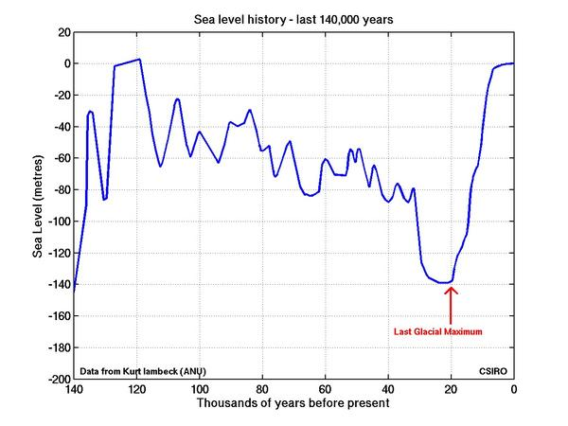
Climate change

Slide 56
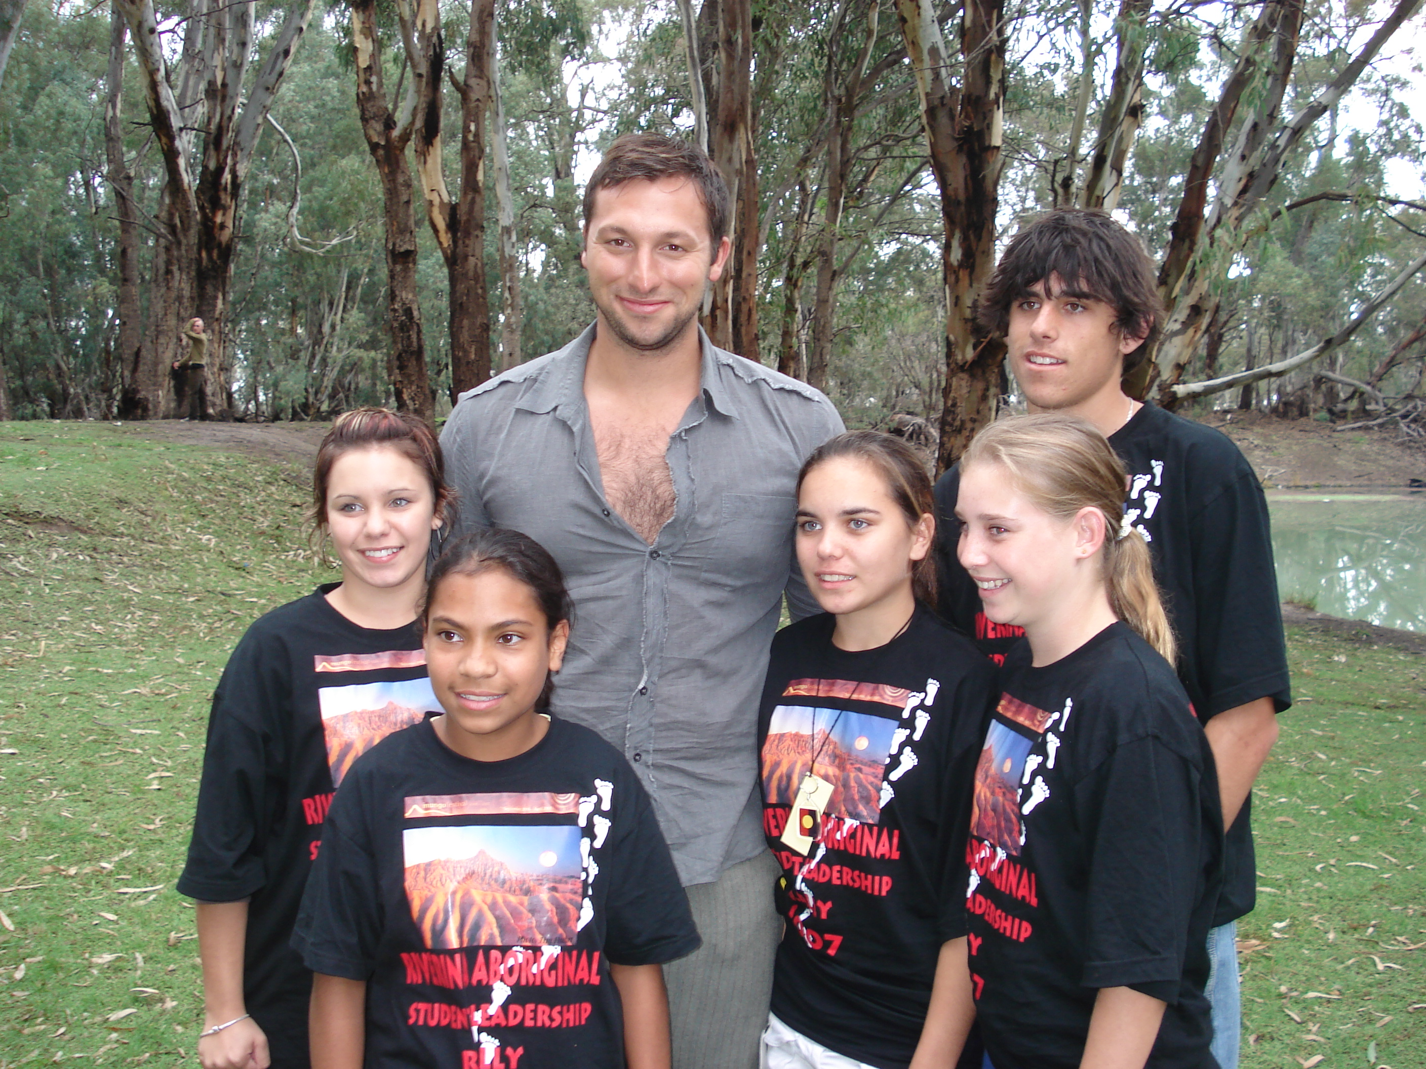
Ian Thorpe

Slide 57
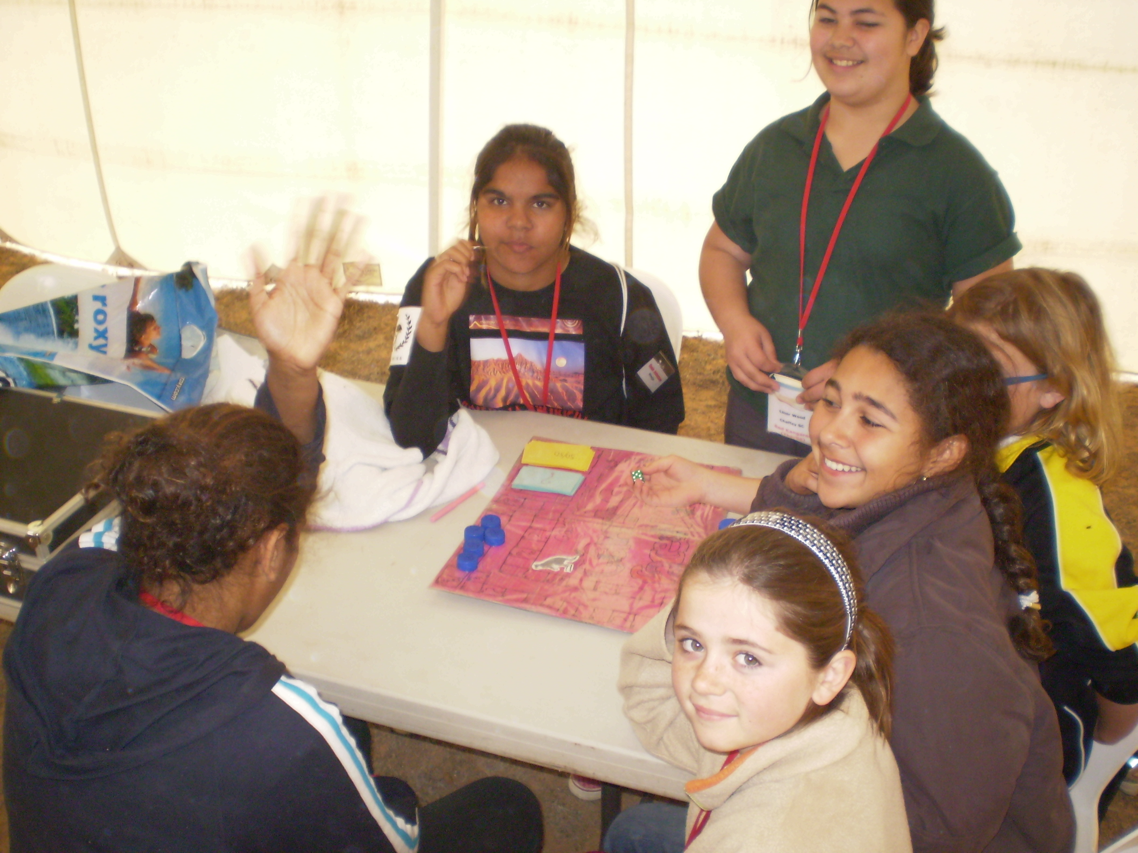

Slide 58
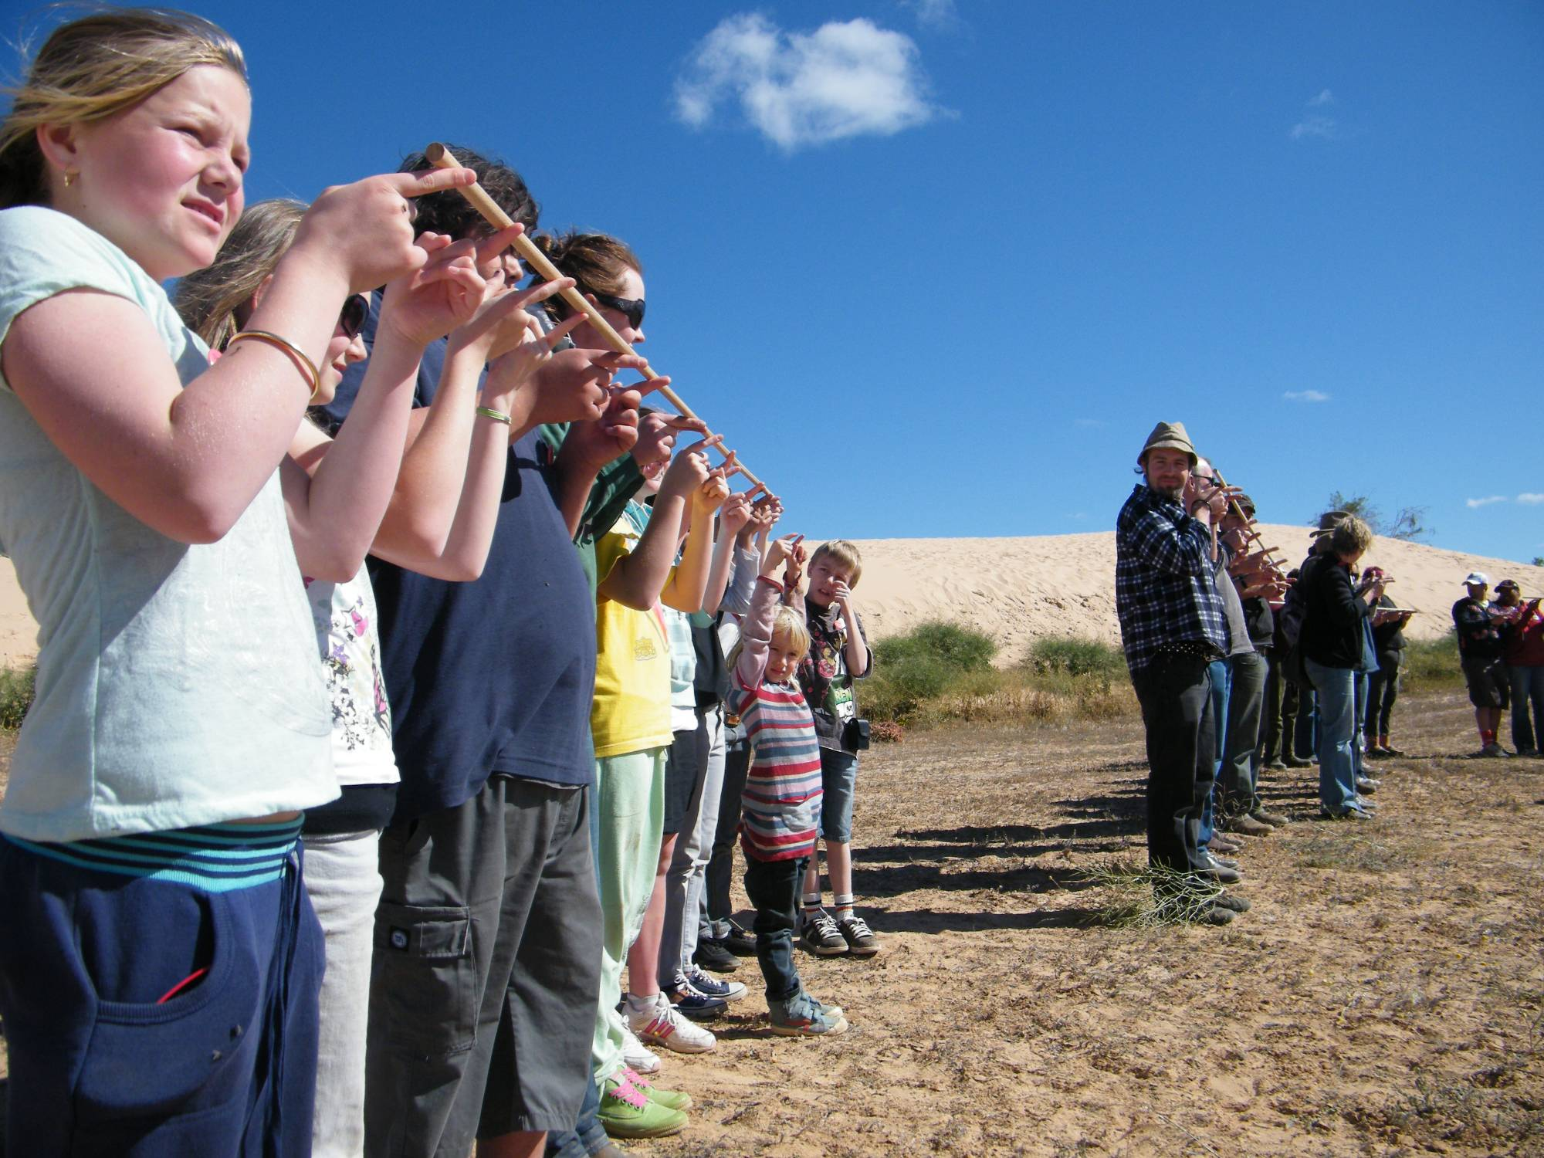

Slide 59
Variation in the Willandra
Robusts and Graciles?
Illustrations by WF Shawcross

Slide 60
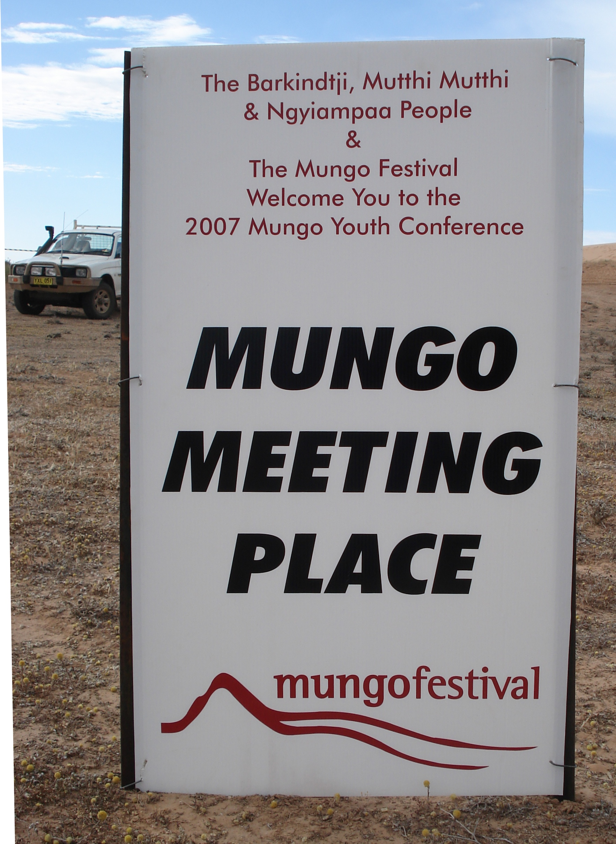

Slide 61
Deep History – Australian History
AGENDA
Presenters
Accessing Deep Time
Purpose
Place
Partners
Education
Program
Outcomes
Future engagement

Slide 62
Shape of the Australian Curriculum: History
        1. History from the time of the earliest human communities to the end of the Ancient period (c. 60,000 BC–c. 500 AD)
        2. History from the end of the Ancient period to the beginning of the Modern period (c. 500–1750)
        3. The Modern World and Australia (1750–1901)
        4. Australia in the Modern World (1901–present)

Slide 63
Partners
Critical ingredient to success
Accessing expertise
Integrity and legitimacy for action

Slide 64
The “kids teaching kids” model
Getting started
Making it happen
  With teachers
  Within class
  Within school
  At the conference
Outcomes
  Student learning is evidenced via their presentation

Slide 65
How schools ‘get started’:
Program forwarded to schools
Schools choose to ‘present’ or ‘attend’
Presenting schools given a presentation pack
Register on line
Presentation concept submitted
Topic confirmed
Advice, coaching and resources identified
Set your 2011 calendar for September

Slide 66
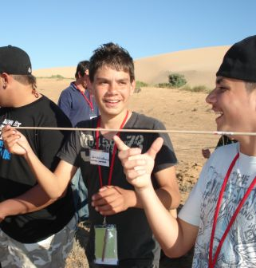
Kids teaching Kids - topics
Culture & Dance
Megafauna
Mungo Man, Mungo Woman
Climate Change - world change
Food, weapons & survival
Initiation - growing up, then and now
Language & linguistics
Traditional lore

Slide 67
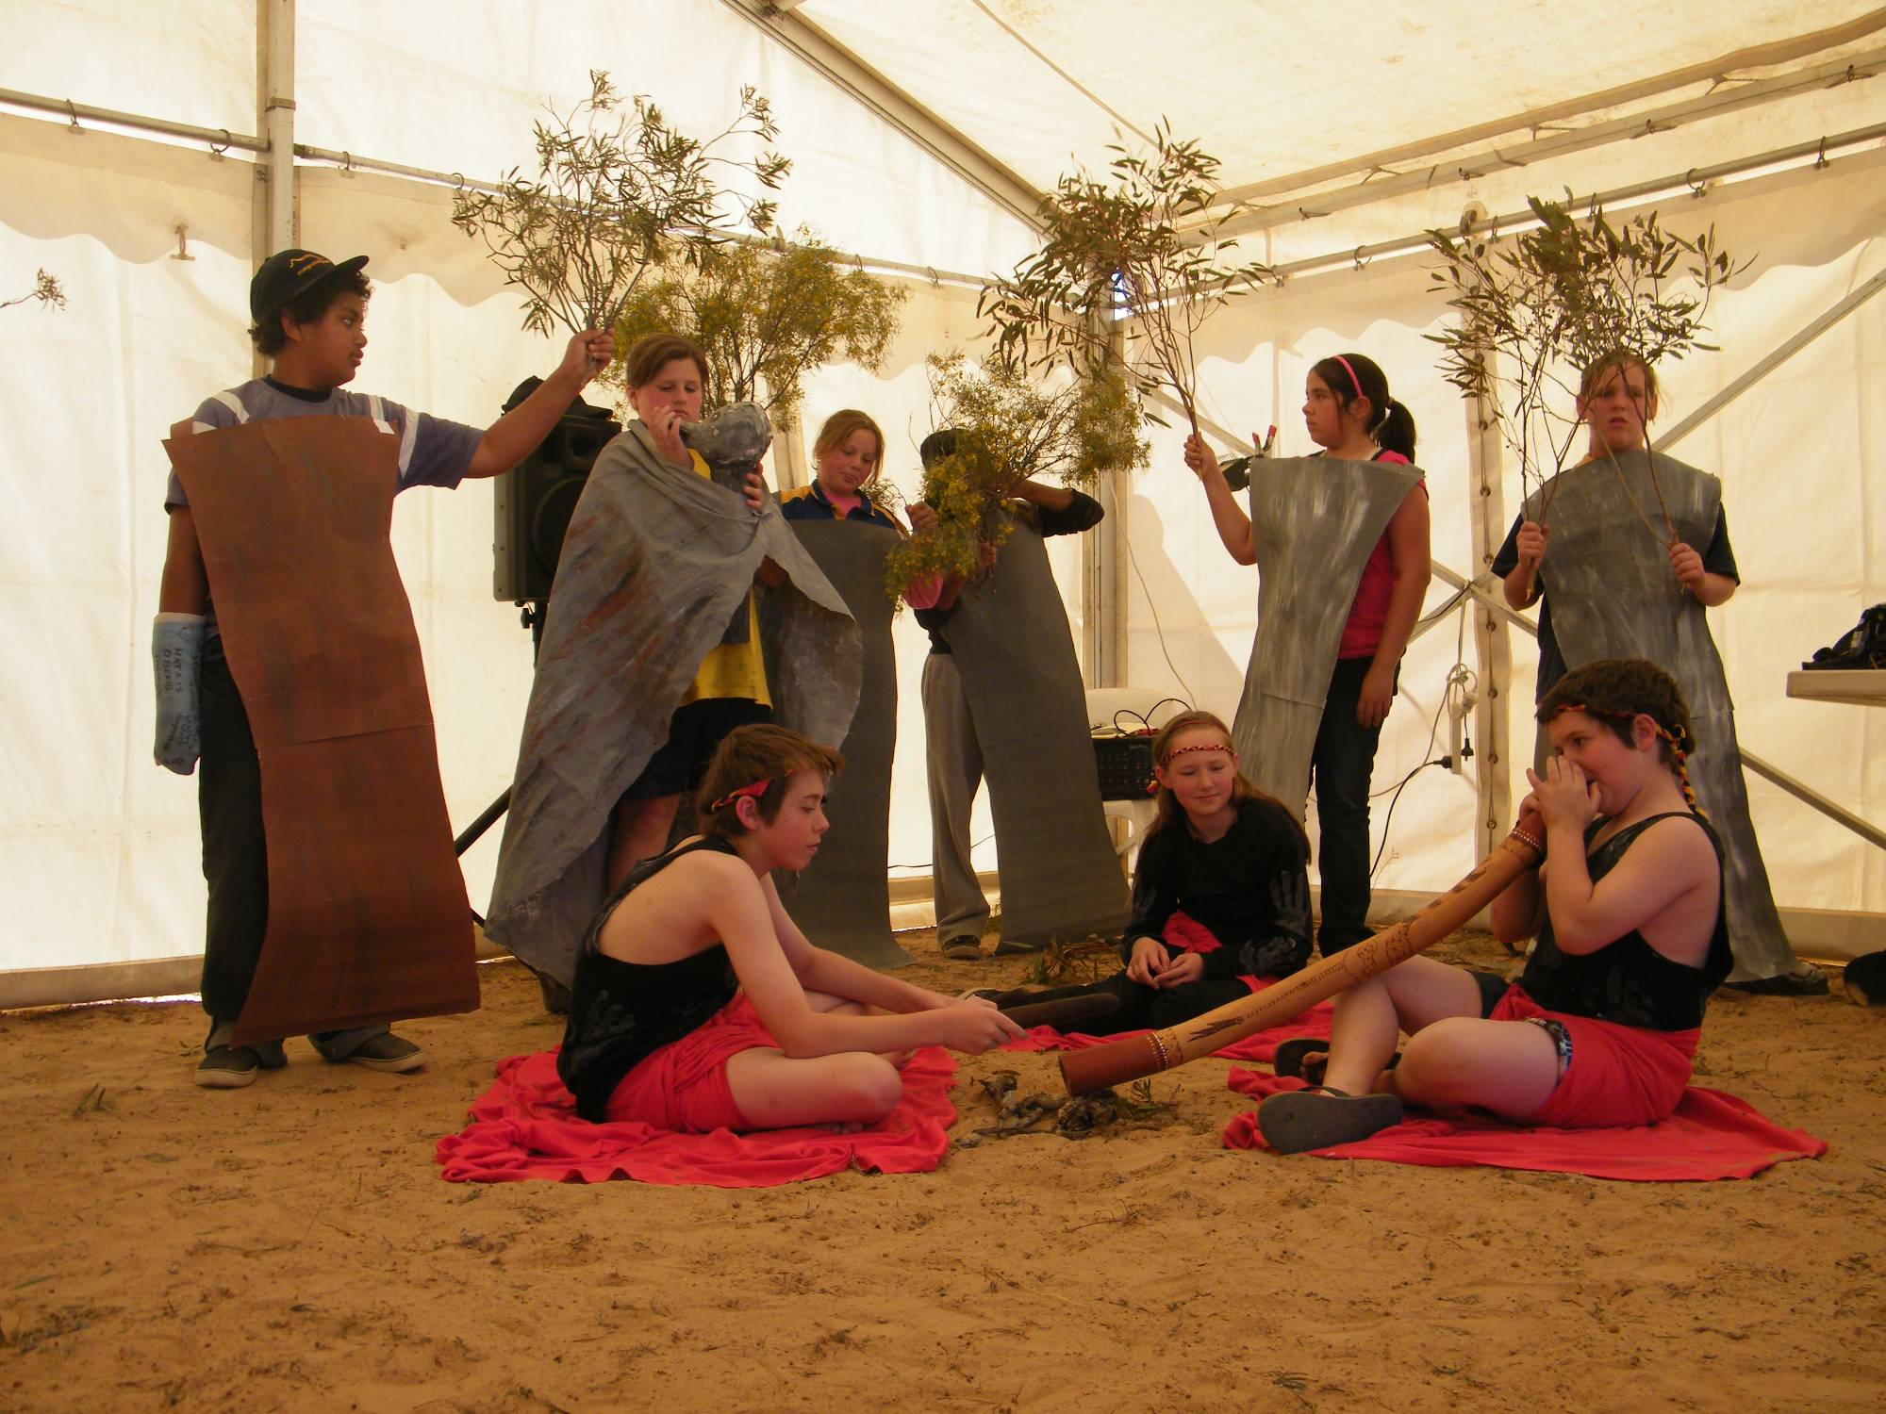

Slide 68
Outcomes
The model has been outstandingly successful in engaging young people, increasing their self confidence and engagement with school, and has the potential to be rolled out across similarly significant sites in Australia and across the wold.

Slide 69
Future Engagement
Next Mungo Youth Conference
Transmission of model
Exchange and interchange

Slide 70
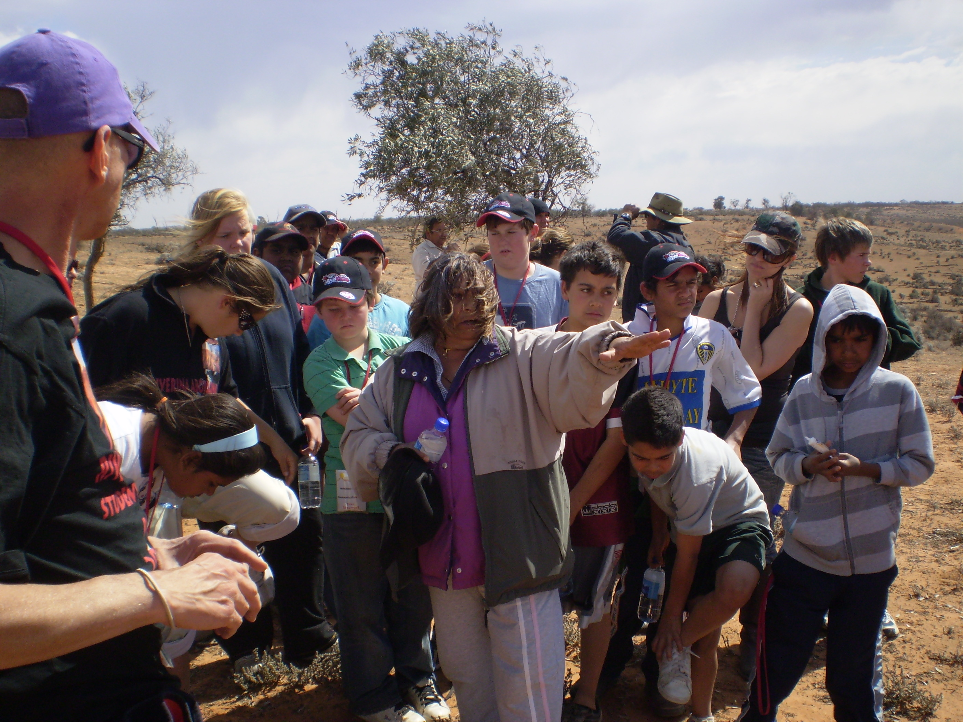
Mutthi Mutthi Elder Mary Pappin presents…

Slide 71
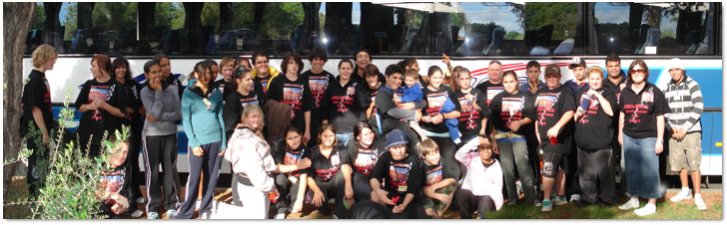
Mt AUSTIN students and staff leaving WAGGA WAGGA

Slide 72
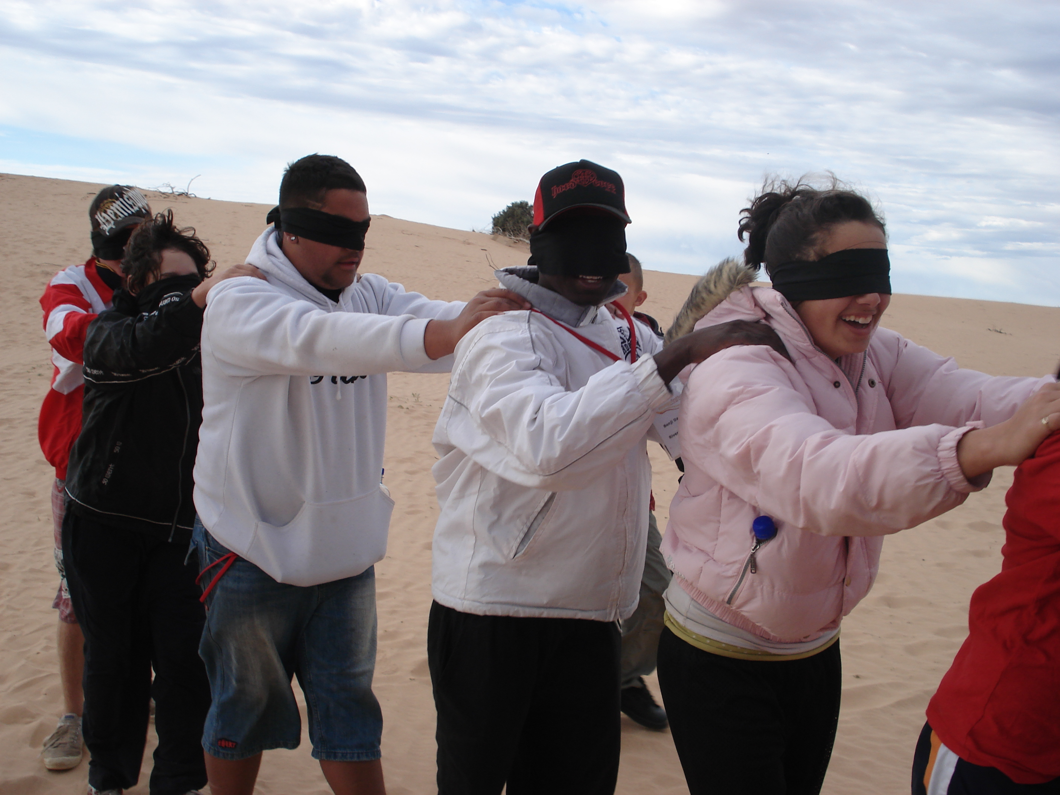

Slide 73
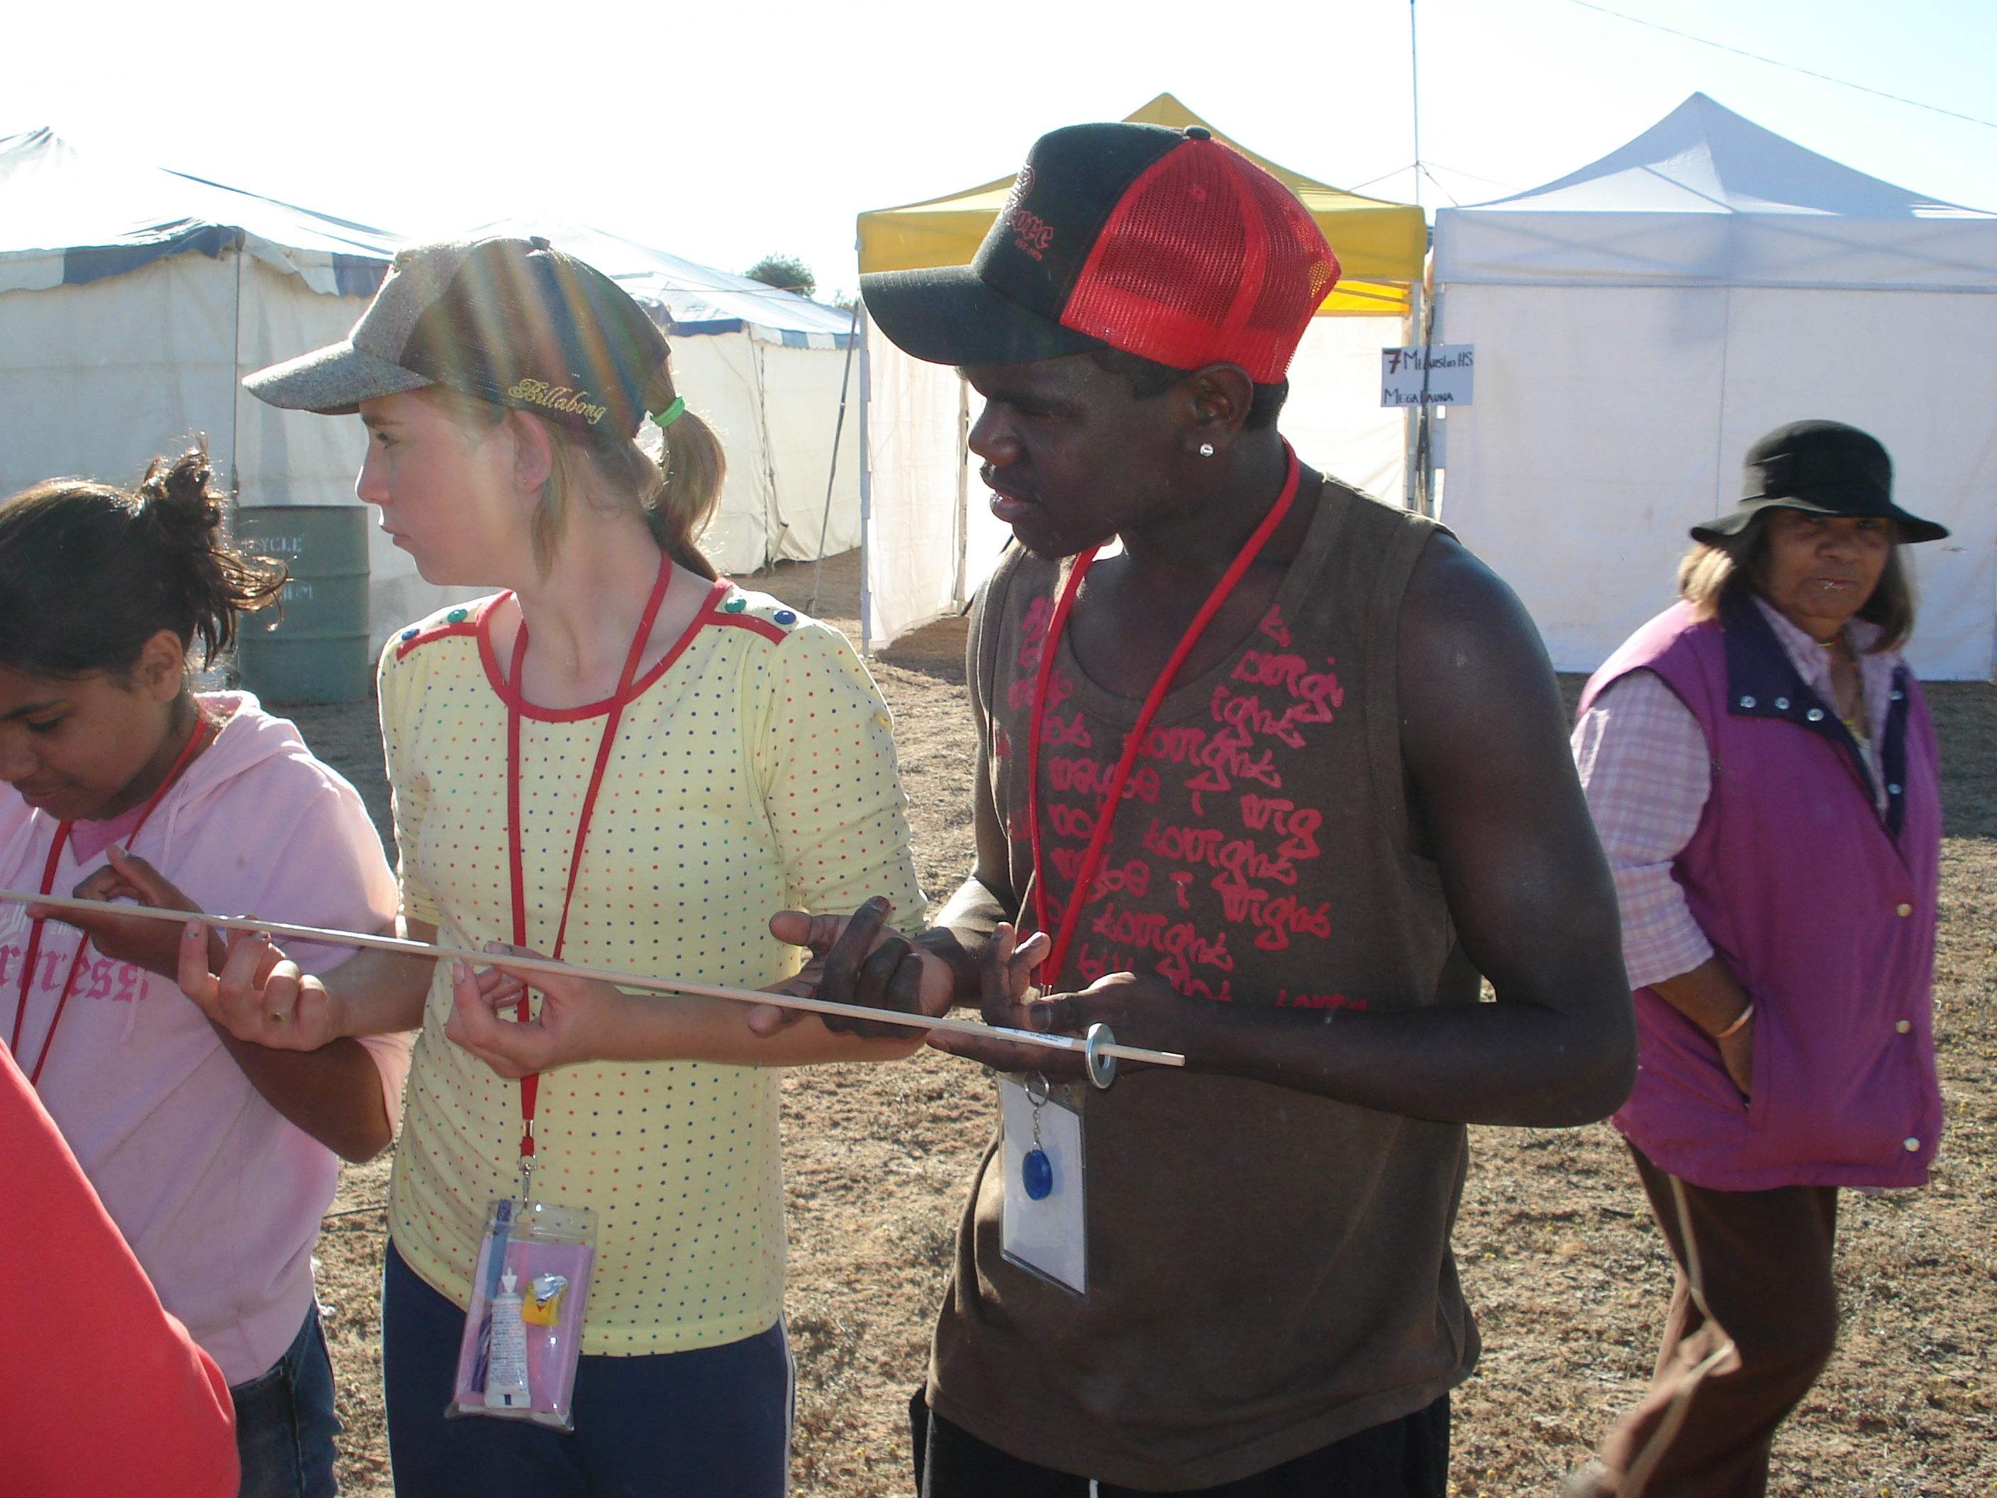

Slide 74
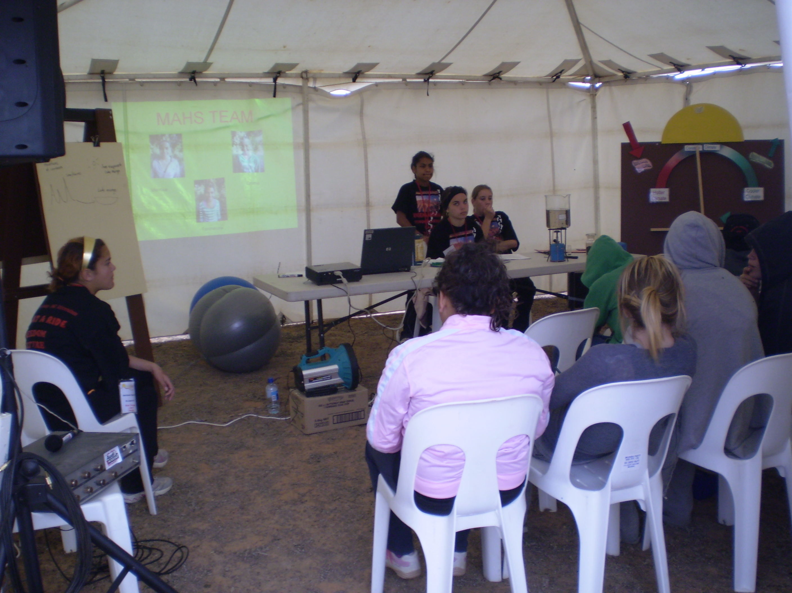

Slide 75
ARWIN REPRESENTATIVES of the
WILLANDRA LAKES REGION WORLD HERITAGE AREA
Ngiyampaa Elder
ROY KENNEDY
Paakantji Elder
MARIE MITCHELL

